Slide 1
Computer Architecture Concepts
Part 11 – Sequential Logic

Slide 2
Objectives
Introduce circuits that depend on their previous input (as well as the current input)

Slide 3
Introduction
So far, we have looked at combinatorial (or combinational) circuits. They take input signals, and the output depends only on those inputs at that time.
To build a computer, we need it to be able to act on previous values (like keeping track of a total)
This needs sequential logic, that is it depends on the sequence of inputs.

Slide 4
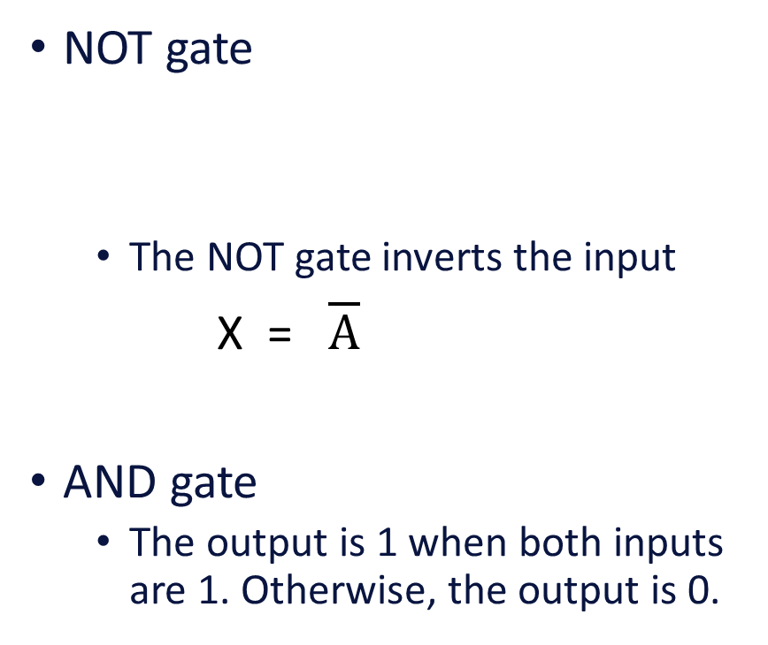
Gates reminder
NOT gate
The NOT gate inverts the input
X = $\overline{A}$
AND gate
The output is 1 when both inputs are 1. Otherwise, the output is 0.
NAND gate
The NAND gate inverts the output from an AND gate
The output will be 0 when both inputs are 1. Otherwise, the output will be 1.

Slide 5
Latch
A latch is a circuit that can store (latch on to) and output one bit of data
A latch has two inputs, one to set the latch to 1 (S), the other to reset the latch to zero (R)
The S and R signals should normally both be off (0) and a brief signal of 1 used to carry out the respective action
A latch has two outputs, the value (Q) and the inverse of that value
A latch can be built using NAND or NOR gates, here we will look at the NAND gate version

Slide 6




Latch constructed from NAND gates
Note that the inputs to the NAND gates include come from the output of the other NAND gate
Note that the signals that go into the latch are inverted (shown by the line above S and R)
When S and R are both 0, the inputs to the latch will both be 1
The output is Q
$$\overline{S}$$
Q
$$\overline{Q}$$
$$\overline{R}$$

Slide 7
Latch constructed from NAND gates
Briefly setting R to 1 sets Q to 0 (reset)
Briefly setting S to 1 sets Q to 1 (set)
Once the latch has been set or reset, Q keeps its value when R and S are both zero
When R and S are both zero (inverted signals both 1) the output Q is 0 or 1
You cannot tell the value of Q just from the current inputs from R and S it depends on the previous values (sequence)
Setting both R and S to 1 at the same time is an illegal state
$$\overline{S}$$
Q
$$\overline{Q}$$
$$\overline{R}$$

Slide 8
Enhancements to Latches
To control signals in a computer, it would be better to store bits at a particular point in time
We don’t want minor variations between components mean that signals aren’t reliable
We enable the latch to store data at a particular time – this is called a gated latch
We don’t want the latch to get into a state where R and S are both 1 at the same time, these can be replaced by a single signal – a D latch
Note that some books and online resources refer to a gated D latch as a flip-flop

Slide 9
Summary
We have introduced a latch which is a simple component that can remember a previous state (0 or 1).
You should create and investigate the latch in the lab session.

